Slide 1
CAPSTONE PROJECT
Power Bi&Tableau
Presented by:
Nithya Somarapu
Sairam Rachakonda

Slide 2
In this project, we will visualise data using two of the most important tools that are popular in the market and are used by the majority of reputable organisations. These are as follows:
1.Power Bi:
This tool can assist in connecting disparate data sets, transforming and cleaning the data into a data model, and creating charts or graphs to visualise the data.
2.Tableau:
The one tool used in business intelligence to visualise data and reveal patterns for analysis, making the data more understandable.
Introduction

Slide 3
Datasets and Tools used
Datasets:
1. Global Sample Superstore Data
2. Covid-19 Data
Tools:
1. Power Bi
2. Tableau
3. Excel

Slide 4




The Major tools used in the whole Project

Slide 5
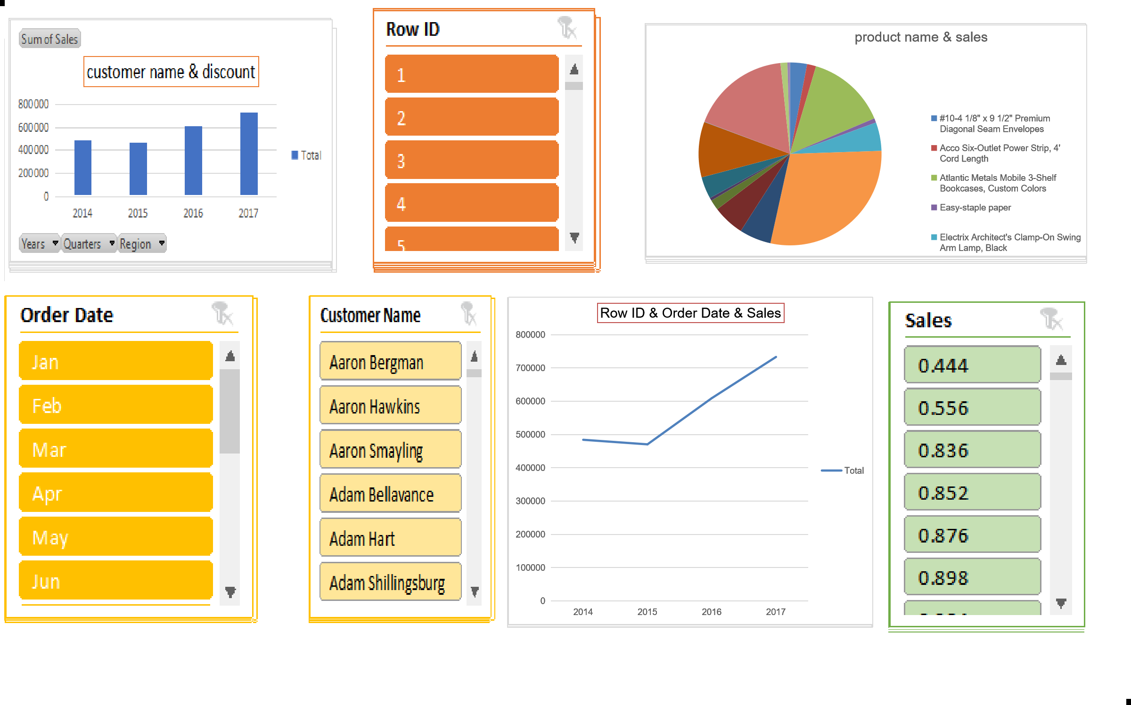
Excel Dashboard Analysis Tools
Excel Dashboard Analysis Tools
Excel Dashboard Analysis Tools
Slicer
Piechart
Cluster chart
Line Chart
Slicer
Piechart
Cluster chart
Line Chart
Slicer
Piechart
Cluster chart
Line Chart
Done Visualizing the Global superstore Data by using the above mentioned charts

Slide 6
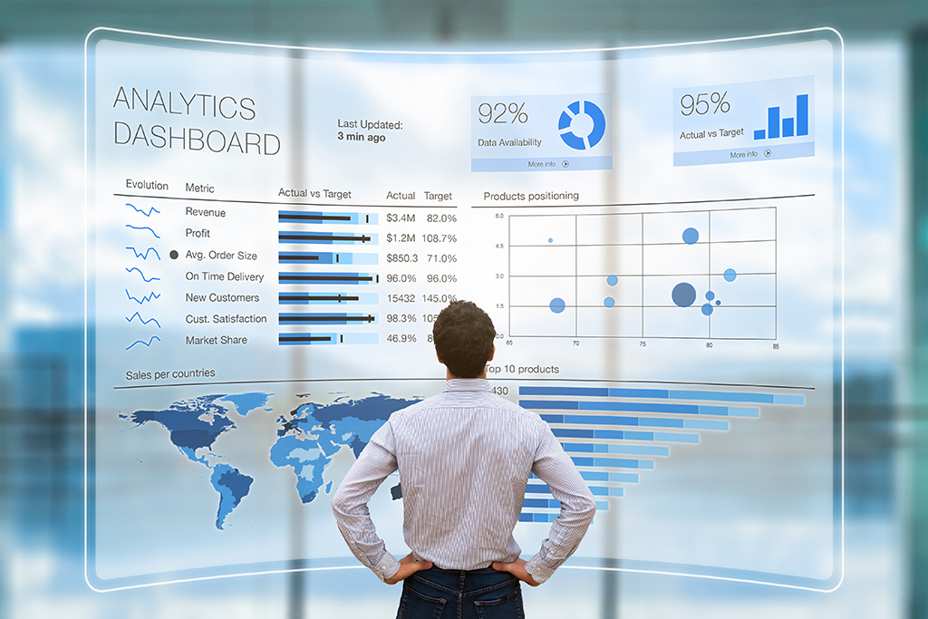
POWER BI
GLOBAL SUPERSTORE DATA

Slide 7
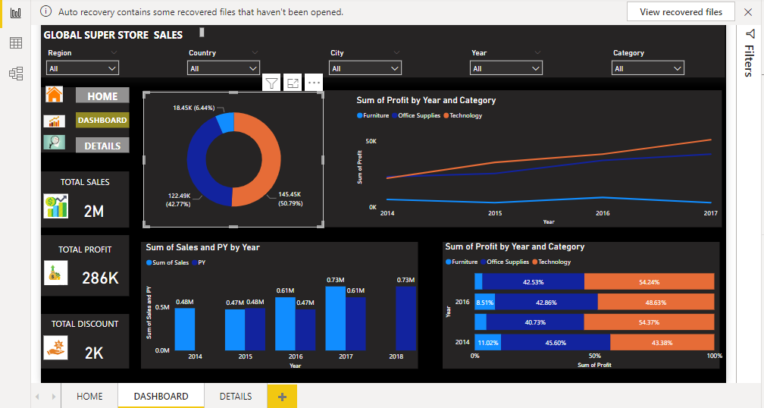
Power bi Dashboard

Slide 8
Represented Visualizations in Power Bi
CLUSTERED COLUMN CHART
DONUT CHART
LINECHART
A grouped bar chart is a type of bar chart that plots numerical values for levels of two categorical variables rather than one.
Donut charts are used to display categorical data proportions, with the size of each piece indicating the proportion of every category.
A line chart is a collection of data points represented by dots and linked by straight lines. A line chart may contain one or more lines. Line charts have two axis: x and y.

Slide 9
Represnted Visualizations in Power Bi
STACKED BAR CHART
SLICERS
BUTTONS&BOOKMARKS
They resemble a series of columns or bars stacked on top of each other and are also known as stacked bar or column charts. Stacked charts are an extremely useful tool for comparisons.
The data value will be represented on the Y-axis in the Stacked bar chart, and the axis will represent the X-axis value.
Slicers include buttons that can be used to filter tables or PivotTables.
Slicers, in addition to quick filtering, also display the current filtering state, making it simple to recognise what is reportedly displayed. A slicer can be used to easily filter data in a table or PivotTable.
You can use buttons in Power BI to create reports that behave similarly to apps and to create an environment in which users can click, and interact with Power BI content.
You can add report bookmarks to capture the current state of a report page when editing a report in Power BI Desktop and the Power BI service.

Slide 10

TABLEAU
COVID-19 DATA

Slide 11
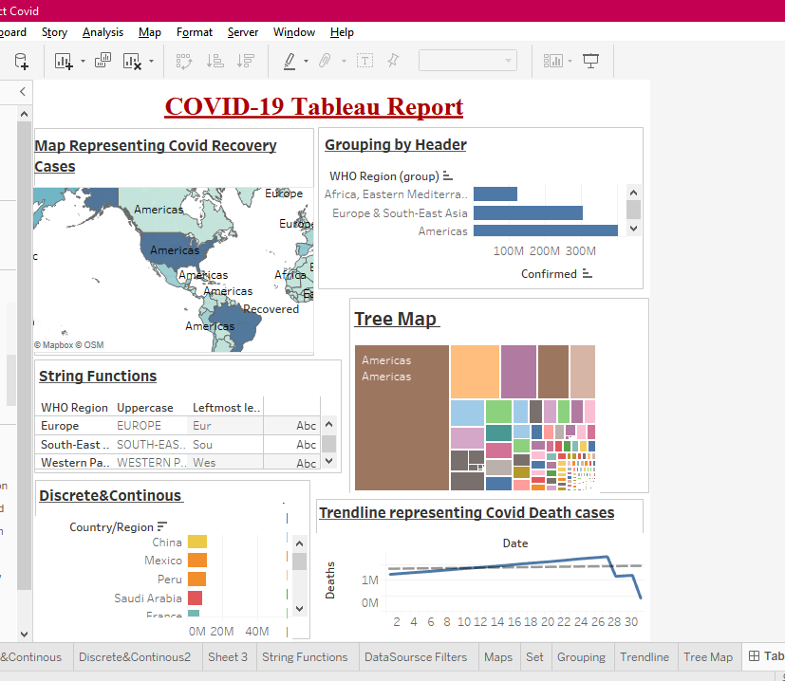
Tableau Dashboard

Slide 12
Represented Visualizations in Tableau
SYMBOL MAPS
LINES
A symbol map is a type of chart in which quantitative values for different locations on a map are represented using built-in or custom symbols. The size, colour, and shape properties of the symbols can be used to make the visual more easy for the user.
The Tableau Line Chart is a visualisation option in which the two axes of a graph represent a dimension (such as time) and a measure (such as a company's sales). This results in the formation of Markers.
HORIZANTAL BARS
TEXT TABLES
The bars are used to illustrate comparisons between categories. The chart's one axis represents the specific categories being compared, while the other axis represents a discrete value."
Text tables are usually created in Tableau by placing one dimension on the Rows shelf and another dimension on the Columns shelf. The view is then completed by dragging one or more measures to Text on the Marks card.

Slide 13
THANK YOU!

